Slide 1
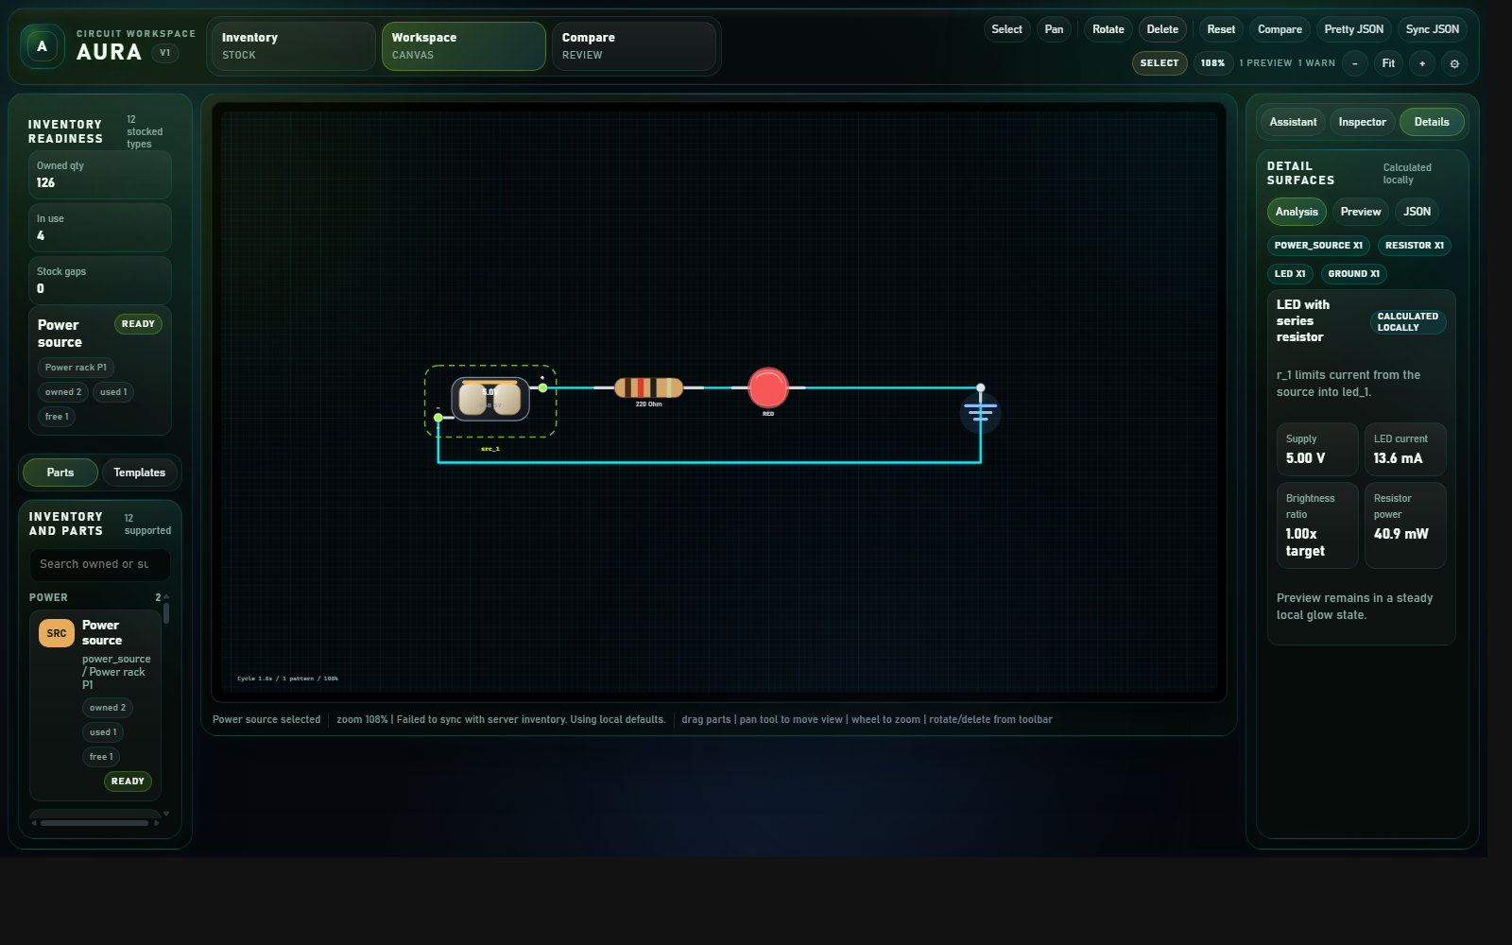
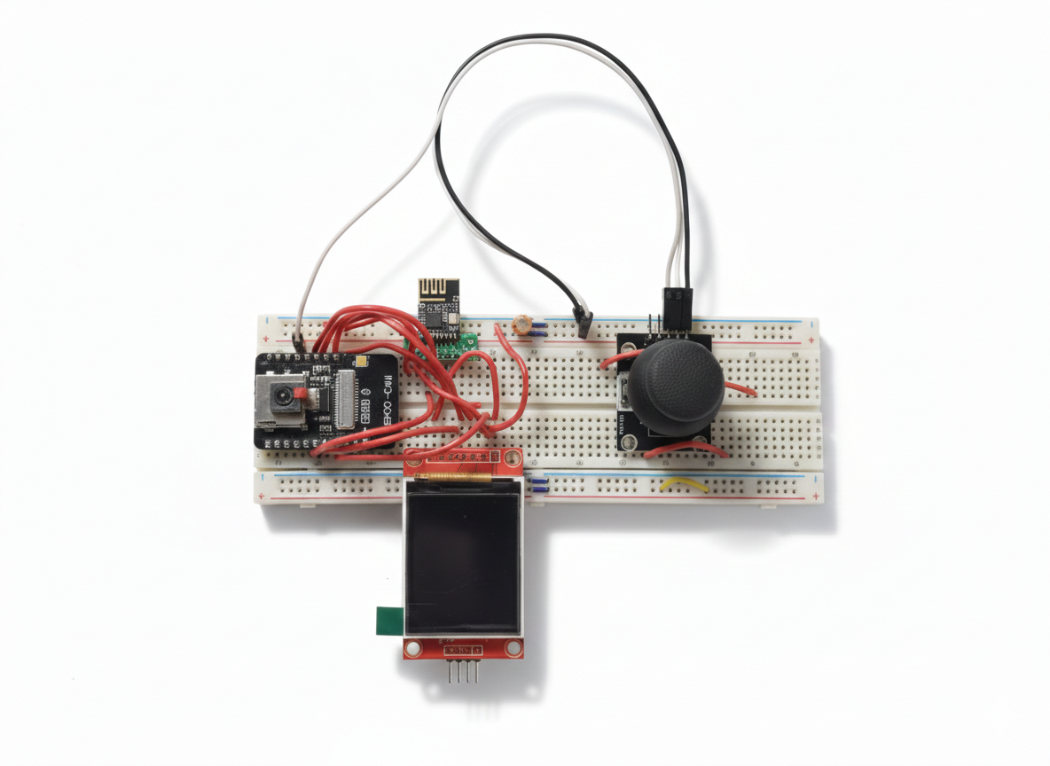
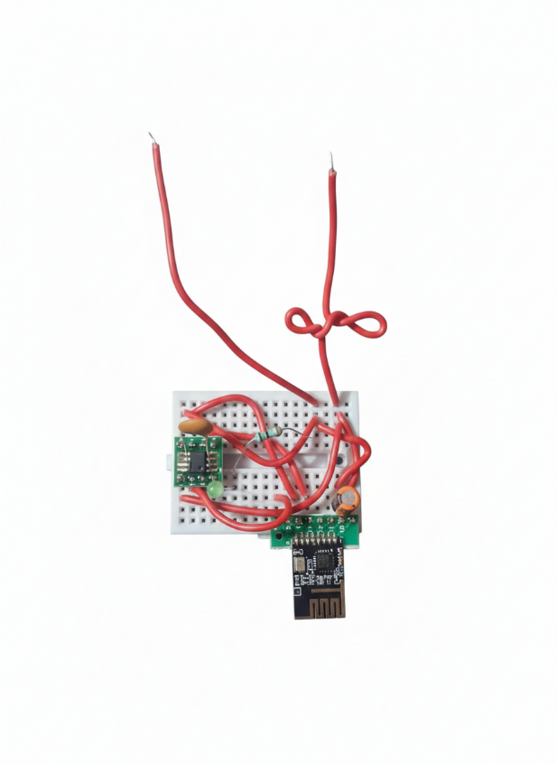
AURA
Autonomous User Realization & Assembly
A cyber-physical platform for physical component localization, inventory-aware reasoning, and deterministic circuit composition.
Presented by Santosh Kumar
B.Tech, Computer Science and Engineering
HMR Institute of Technology and Management
Supervisor: Ms. Indu Sharma
Coordinator: Dr. Naveen Sharma
Current AURA workspace
Prototype-level system
Inventory aware
Host prototype
Node prototype

Slide 2
Problem Statement
02
Why existing workflows are still inefficient for students, makers, and small labs.
Finding parts is slow
Inventory is uncertain
Digital tools ignore reality
Component storage is often distributed across drawers, boxes, and shelves, so users spend time searching instead of building.
Users may know a resistor box exists, but not whether the exact value and quantity are sufficient for the project.
Typical circuit tools help create virtual designs without considering what the user physically owns at that moment.
Retrieval is manual
AI can be too loose
Learning suffers
Even after choosing a design, the user still has to gather every required part through repeated trial-and-error searching.
Unconstrained suggestions may sound useful, but they remain hard to audit if they are not grounded in structured deterministic data.
When retrieval, stock awareness, and design review are disconnected, students lose clarity about both the circuit and the build process.
AURA addresses these as one integrated problem: search, stock awareness, deterministic planning, review, and physical retrieval.
AURA | Autonomous User Realization & Assembly

Slide 3
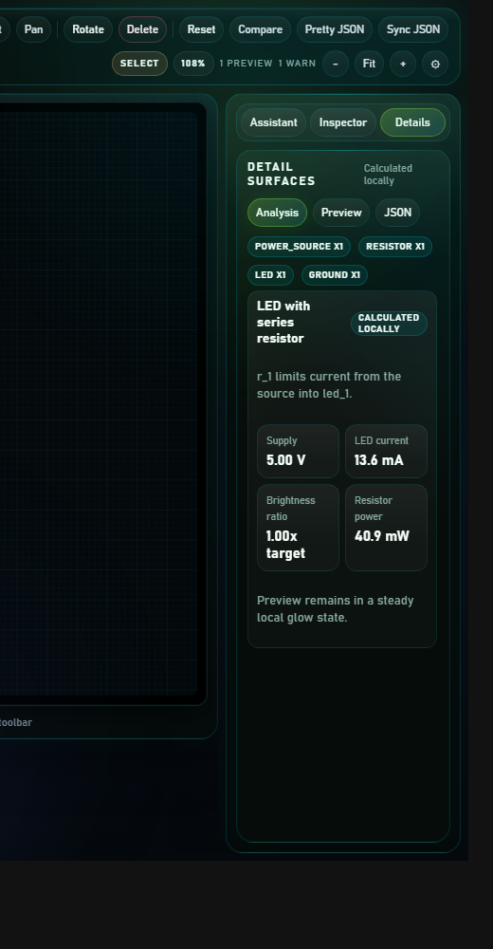
Project Vision
03
AURA combines physical intelligence and structured digital assistance in one platform.
Physical locator network
Inventory intelligence
Deterministic workspace
Tracks component type, value, quantity, and physical address so the system can answer:
â€¢ What part is available?
â€¢ Where is it stored?
â€¢ Is the available count sufficient?
Host side
Analysis and review surface
ESP32 host, distributed nodes, addressed communication, visual indication, and location-aware retrieval.
Canonical JSON, local checking, inventory-aware proposals, and reviewable revisions before any locate action.
Three layers -> one workflow
AURA | Autonomous User Realization & Assembly

Slide 4
Overall System Architecture
04
Host-mediated control keeps the hardware path reliable while supporting richer digital interaction.
ESP32 host controller
Smartphone / user input
Distributed locator nodes
Physical components / storage
Local UI, metadata, Bluetooth bridge, node control
Inventory and metadata layer
Deterministic circuit workspace
AI assistance
Value, quantity, storage address, optional notes, media, and project linkage.
Canonical JSON, local rules, compare mode, backend persistence, and honest preview boundaries.
Structured suggestions, explanations, alternatives, and revisions grounded by deterministic data.
AURA | Autonomous User Realization & Assembly

Slide 5
Hardware Prototype and Design Logic
05
The hardware model is designed for affordability, low power use, and flexible storage layouts.
Hardware stack
â€¢ ESP32 host for local search, metadata, Bluetooth, and RF bridging
â€¢ ATtiny404 + nRF24L01+ node model for addressed low-power indication
â€¢ WS2812B visual output for drawers, bins, and grouped storage strips
â€¢ Optional buzzer/project marker extension
ESP32 host prototype
Low-power node prototype
Why this hardware model is practical
One node can control multiple nearby indicator positions in a dense storage row, which keeps the system affordable. When storage is spread across a room, more nodes can be added without changing the basic host-driven architecture.
AURA | Autonomous User Realization & Assembly

Slide 6
Software Workspace Overview
06
The software side is built around structured data, local checking, and reviewable assistance.
Current software strengths
â€¢ Canonical JSON remains the source of truth
â€¢ Local deterministic analysis runs before blind AI reasoning
â€¢ Backend-backed persistence supports compare and apply workflows
â€¢ Inventory awareness is kept in the authoring loop
â€¢ Preview behavior is shown clearly as illustrative, not electrically verified
Current workspace overview
Local-first
Reviewable
AURA | Autonomous User Realization & Assembly

Slide 7
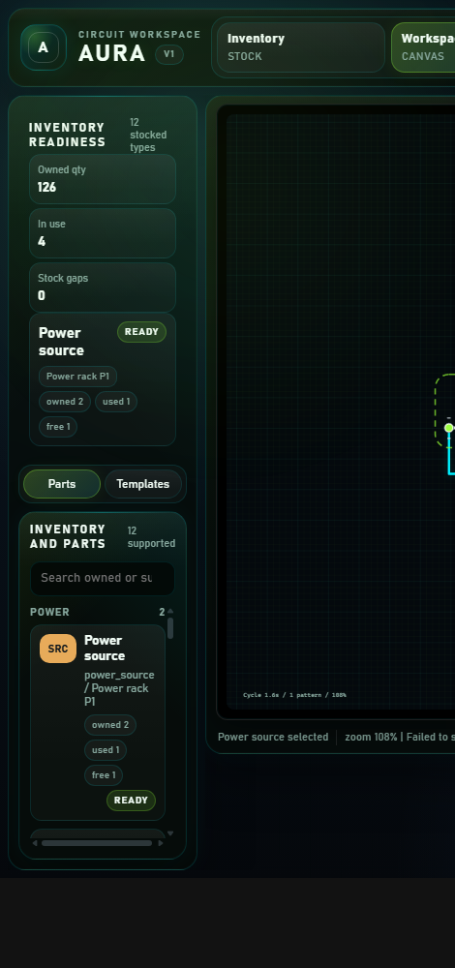
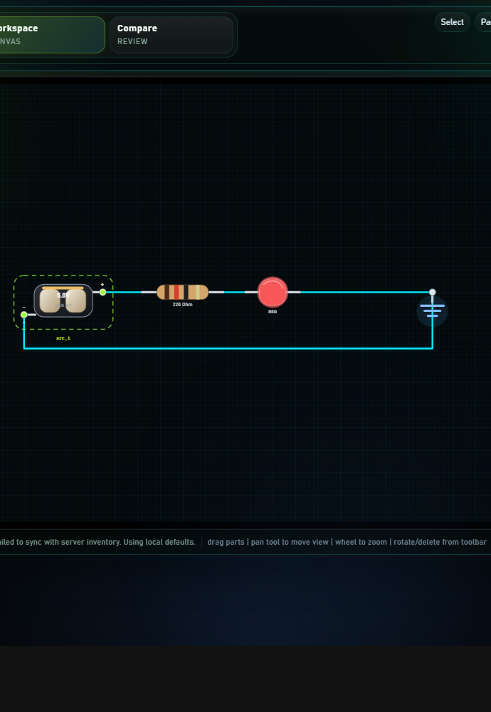
Web UI Breakdown
07
The interface supports workspace editing, canvas review, and analysis without treating the screenshot as truth.
Left panel / project controls
Canvas and circuit space
Analysis / explanation surface
This layout matters because AURA is not only a locator tool; it is also the decision surface where inventory-aware circuit proposals are reviewed before the user retrieves real parts.
AURA | Autonomous User Realization & Assembly

Slide 8
End-to-End Workflow
08
AURA is strongest as an operational sequence rather than a collection of separate modules.
1
2
3
4
5
User request
Inventory check
Circuit composition
Review
Locate
Search for a part or ask for a circuit goal.
Filter by owned values, quantities, and locations.
Build a deterministic structured representation.
Inspect and accept the proposal in the workspace.
Host activates addressed nodes for required parts.
Interface state during authoring and review
AURA | Autonomous User Realization & Assembly

Slide 9
Academic Contribution and Practical Benefits
09
The project contribution is both architectural and user-facing.
Academic contribution
Practical benefits
â€¢ A unified cyber-physical architecture for electronics assistance
â€¢ A host-and-node retrieval model linked to inventory-aware circuit planning
â€¢ Deterministic JSON-first circuit representation
â€¢ Structured AI proposals grounded by local logic and inventory context
â€¢ Whole-project component highlighting after design selection
â€¢ Less time wasted in physical part searching
â€¢ Better awareness of available values and quantities
â€¢ Faster project preparation when many parts are required
â€¢ More trustworthy AI assistance because results remain inspectable
â€¢ Better learning support for students building from real inventory
AURA | Autonomous User Realization & Assembly

Slide 10
Prototype Status, Limitations, and Next Work
10
The system is presented as a complete prototype-level workflow, not a final deployed product.
What is already demonstrated
Current limitations
Near-term next steps
â€¢ Integrated architecture
â€¢ Prototype host and node direction
â€¢ Inventory-aware workflow
â€¢ Deterministic workspace
â€¢ Structured documentation and conference material
â€¢ Prototype packaging is still evolving
â€¢ Large-scale deployment is not yet validated
â€¢ UI and companion-app polish can improve
â€¢ Full electrical simulation is out of scope
â€¢ Broader component coverage remains future work
â€¢ PCB refinement for cleaner hardware realization
â€¢ Companion-app improvement and voice-assisted search
â€¢ Broader multi-node deployment
â€¢ More component ingestion and authoring support
â€¢ Further validation with real use cases
AURA | Autonomous User Realization & Assembly

Slide 11
AURA closes the gap between digital design and real-world component retrieval.
It is not only a circuit authoring interface and not only a locator network. It is a combined system that helps a user decide, review, and gather the right parts from the inventory they actually own.
Workspace
Search
Compose
Review
Locate
Thank you
Questions and Discussion
Host
Node
Santosh Kumar | B.Tech CSE | HMR Institute of Technology and Management

